Slide 1
Status of Statistics Curricula in Canada
(a graphical study)
Sotirios Damouras & Sohee Kang
U of T Scarborough

Slide 2
Data Sources
Stats program enrolments/graduates: Postsecondary Student Information System (PSIS) survey, from Statistics Canada (StatCan)
Microdata available through StatCan’s RTRA
Stats program curricula: collected from universities’ calendars
Many thanks to Olivia Rennie (UTSC NeuroSci BSc) for her help
All data & code available through GitHub
https://github.com/damouras/SoSC

Slide 3
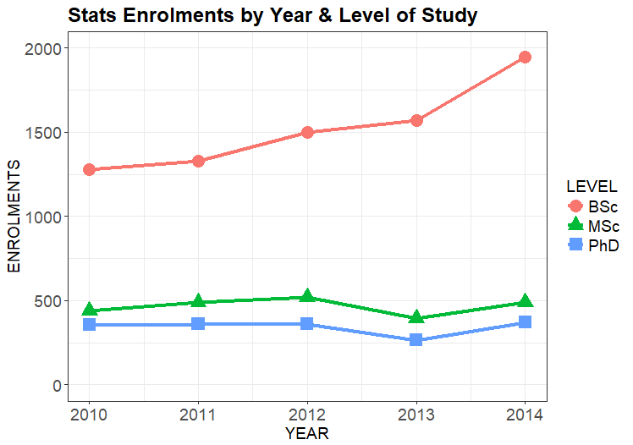
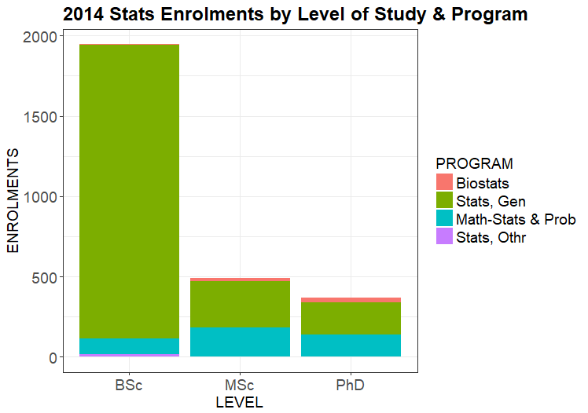
Stats Programs Vital Statistics
52% increased BSc
enrolments (`10 to `14)
Majority of BSc in
General Statistics
Notes:
Growth of
Twice as many BSc than MSc graduates! Contrast to US :
twice as many BSc grads per capita in Canada ( (375/36)/(1700/321) ~ 2)
Similar total grads ( (600/36)/(5000/321) ~ 1)

Slide 4
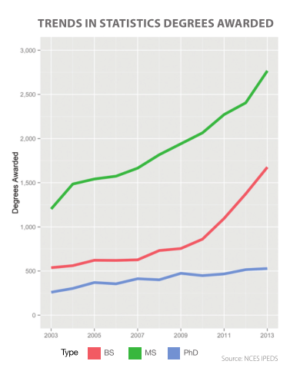
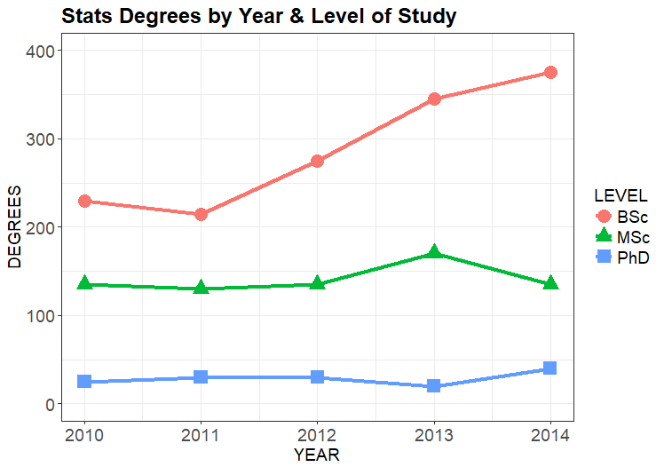
Stats Programs Vital Statistics
Different from US
(where MSc > BSc)
>2 times more BSc
than MSc+PhD grads
CANADA
USA
(reproduced from 2014 ASA Curriculum Guidelines
for undergraduate programs in statistical Science)

Slide 5
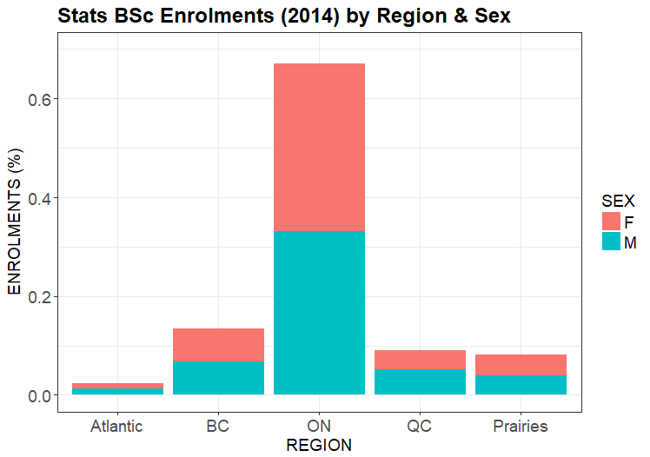
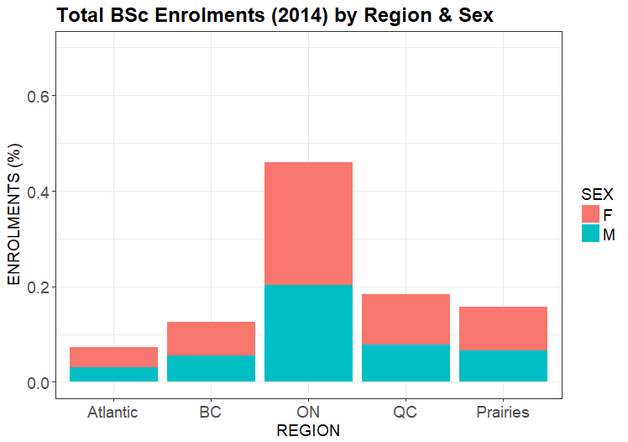
Stats BSc Enrolment Breakdown
Gender Parity!!
(F/M = 970/975)
ON has relatively more Stats BSc’s;
Atlantic/QC/Prairies have less
Stats BSc
All BSc

Slide 6
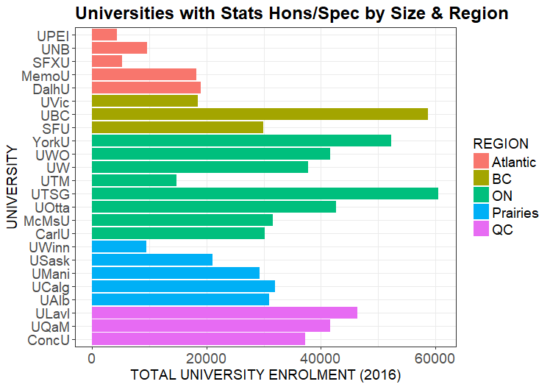
Stats Curricula - Target Population
Only considered (pure) Statistics Honours/Specialist BSc programs
Excludes Minor, Major, 3-yr BA/BSc, etc
Excludes programs with not focused on Statistics (e.g. Probability & Statistics, Mathematical Statistics, etc)
Analyzed programs from n=24 Universities

Slide 7
Curriculum Data
Variable | Description | Format | Values
Code | Course code | TEXT | e.g. STAB22H3
Title | Course title | TEXT | e.g. Statistics I
Credits | This can be tricky, as universities can have different conventions. To keep the variable numeric, use 1 for 2-semester courses (i.e. like UofT's Y courses), .5 for 1-semester courses (UofT's H-courses, should be most common option), and other fractions where applicable (e.g. a half-semester course would have .25 credits) | NUMERIC | e.g. 1.0
Description | Course description | TEXT | Copy-paste from calendar , no pre-reqs or exclusions
Discipline |  | CATEGORICAL | One or more of: MATH, STAT, COMP, OTHR
Level | Effectively, the year the course is offered in. It is usually included in the course code ( I think UTSC is the only University in North America using A,B,C,D) | CATEGORICAL | One or more of : 1, 2, 3, 4
Type | Include electives as courses with partial info (i.e. field can be missing) | CATEGORICAL | One of: R, E, FE
Category | One or more course types from: MT: Mathematics PT: Probability Theory (incl. Stochastic Processes) CS: Computing ST: Statistical Theory SM: Statistical Methodology SP: Statistical Practice OT: Other | CATEGORICAL | One or more of: MT, PT, CS, ST, SM, SP, OT
Comments | Use this field for for anything out of the ordinary that you want to point out | TEXT

Slide 8
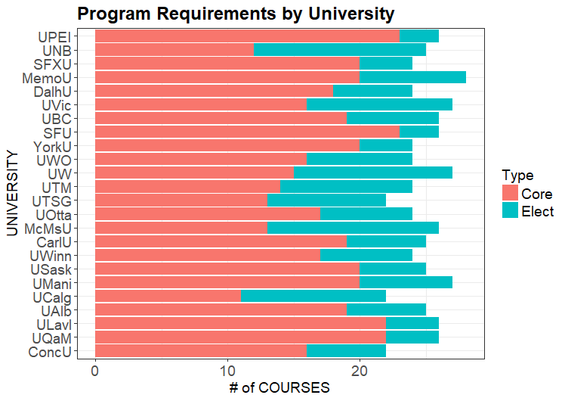
Number of Courses
25 semester courses required on average; with most programs between 24-26 (i.e. 12 - 13 full-year equivalents, or 72 - 78 credit hours)
70% of courses specified (core)
Most ranging between 60% - 80%

Slide 9
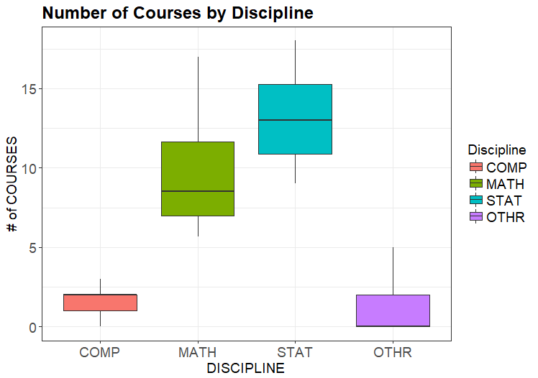
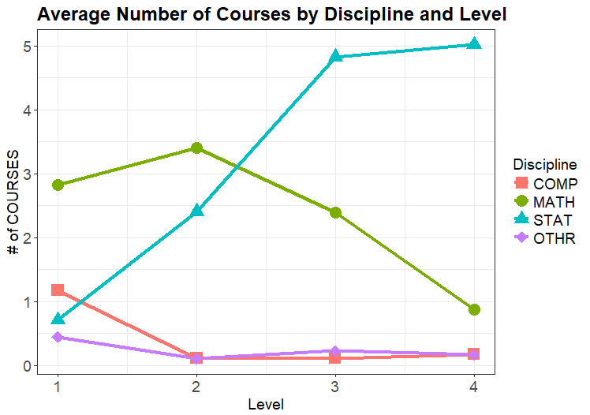
Breakdown of Courses per Discipline
52% STAT courses on average
(and 38% MATH courses)
few STAT courses in
1st year (mostly none)

Slide 10
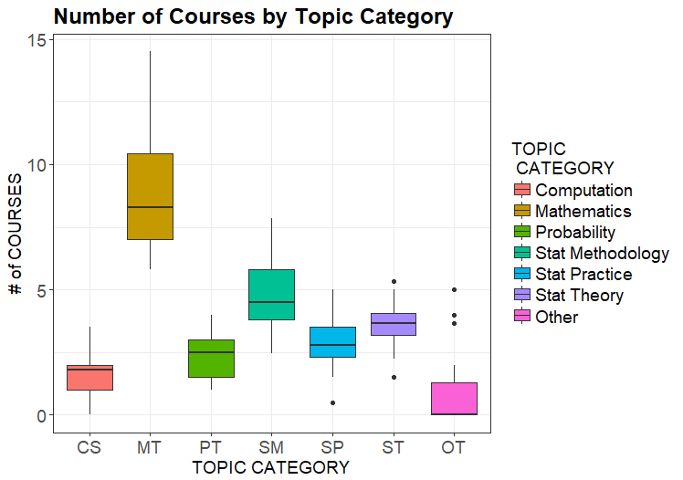
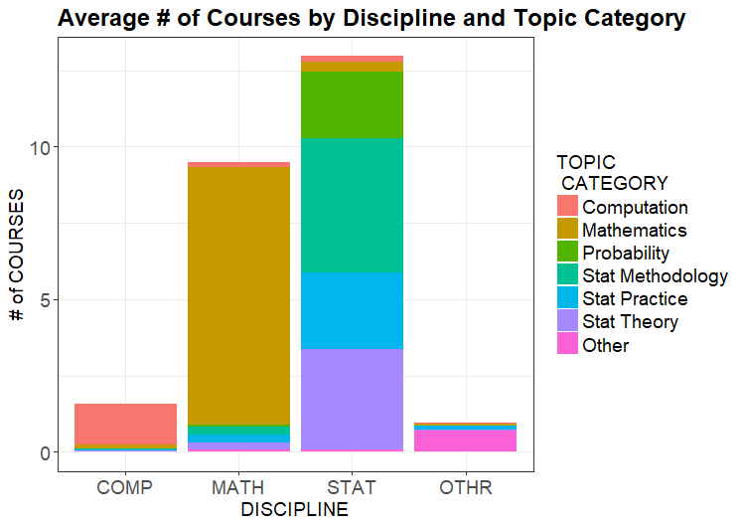
Breakdown of Courses per Topic Category
Practice is least
developed Stats topic
Math/Prob-heavy curriculum

Slide 11
Conclusions
Train Stats Hons/Spec BSc’s primarily for the workplace (rather than for graduate study)
Offer more Stats-specific courses (at expense of Math courses)
Focus courses (new or existing) on Statistical Practice
Start with Stats courses early on (1st year)

